Slide 1
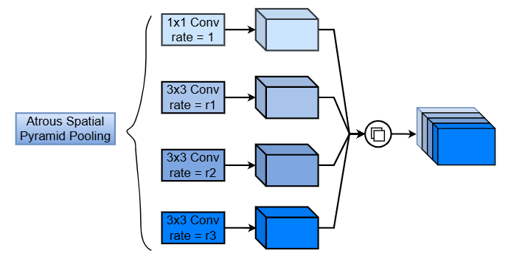
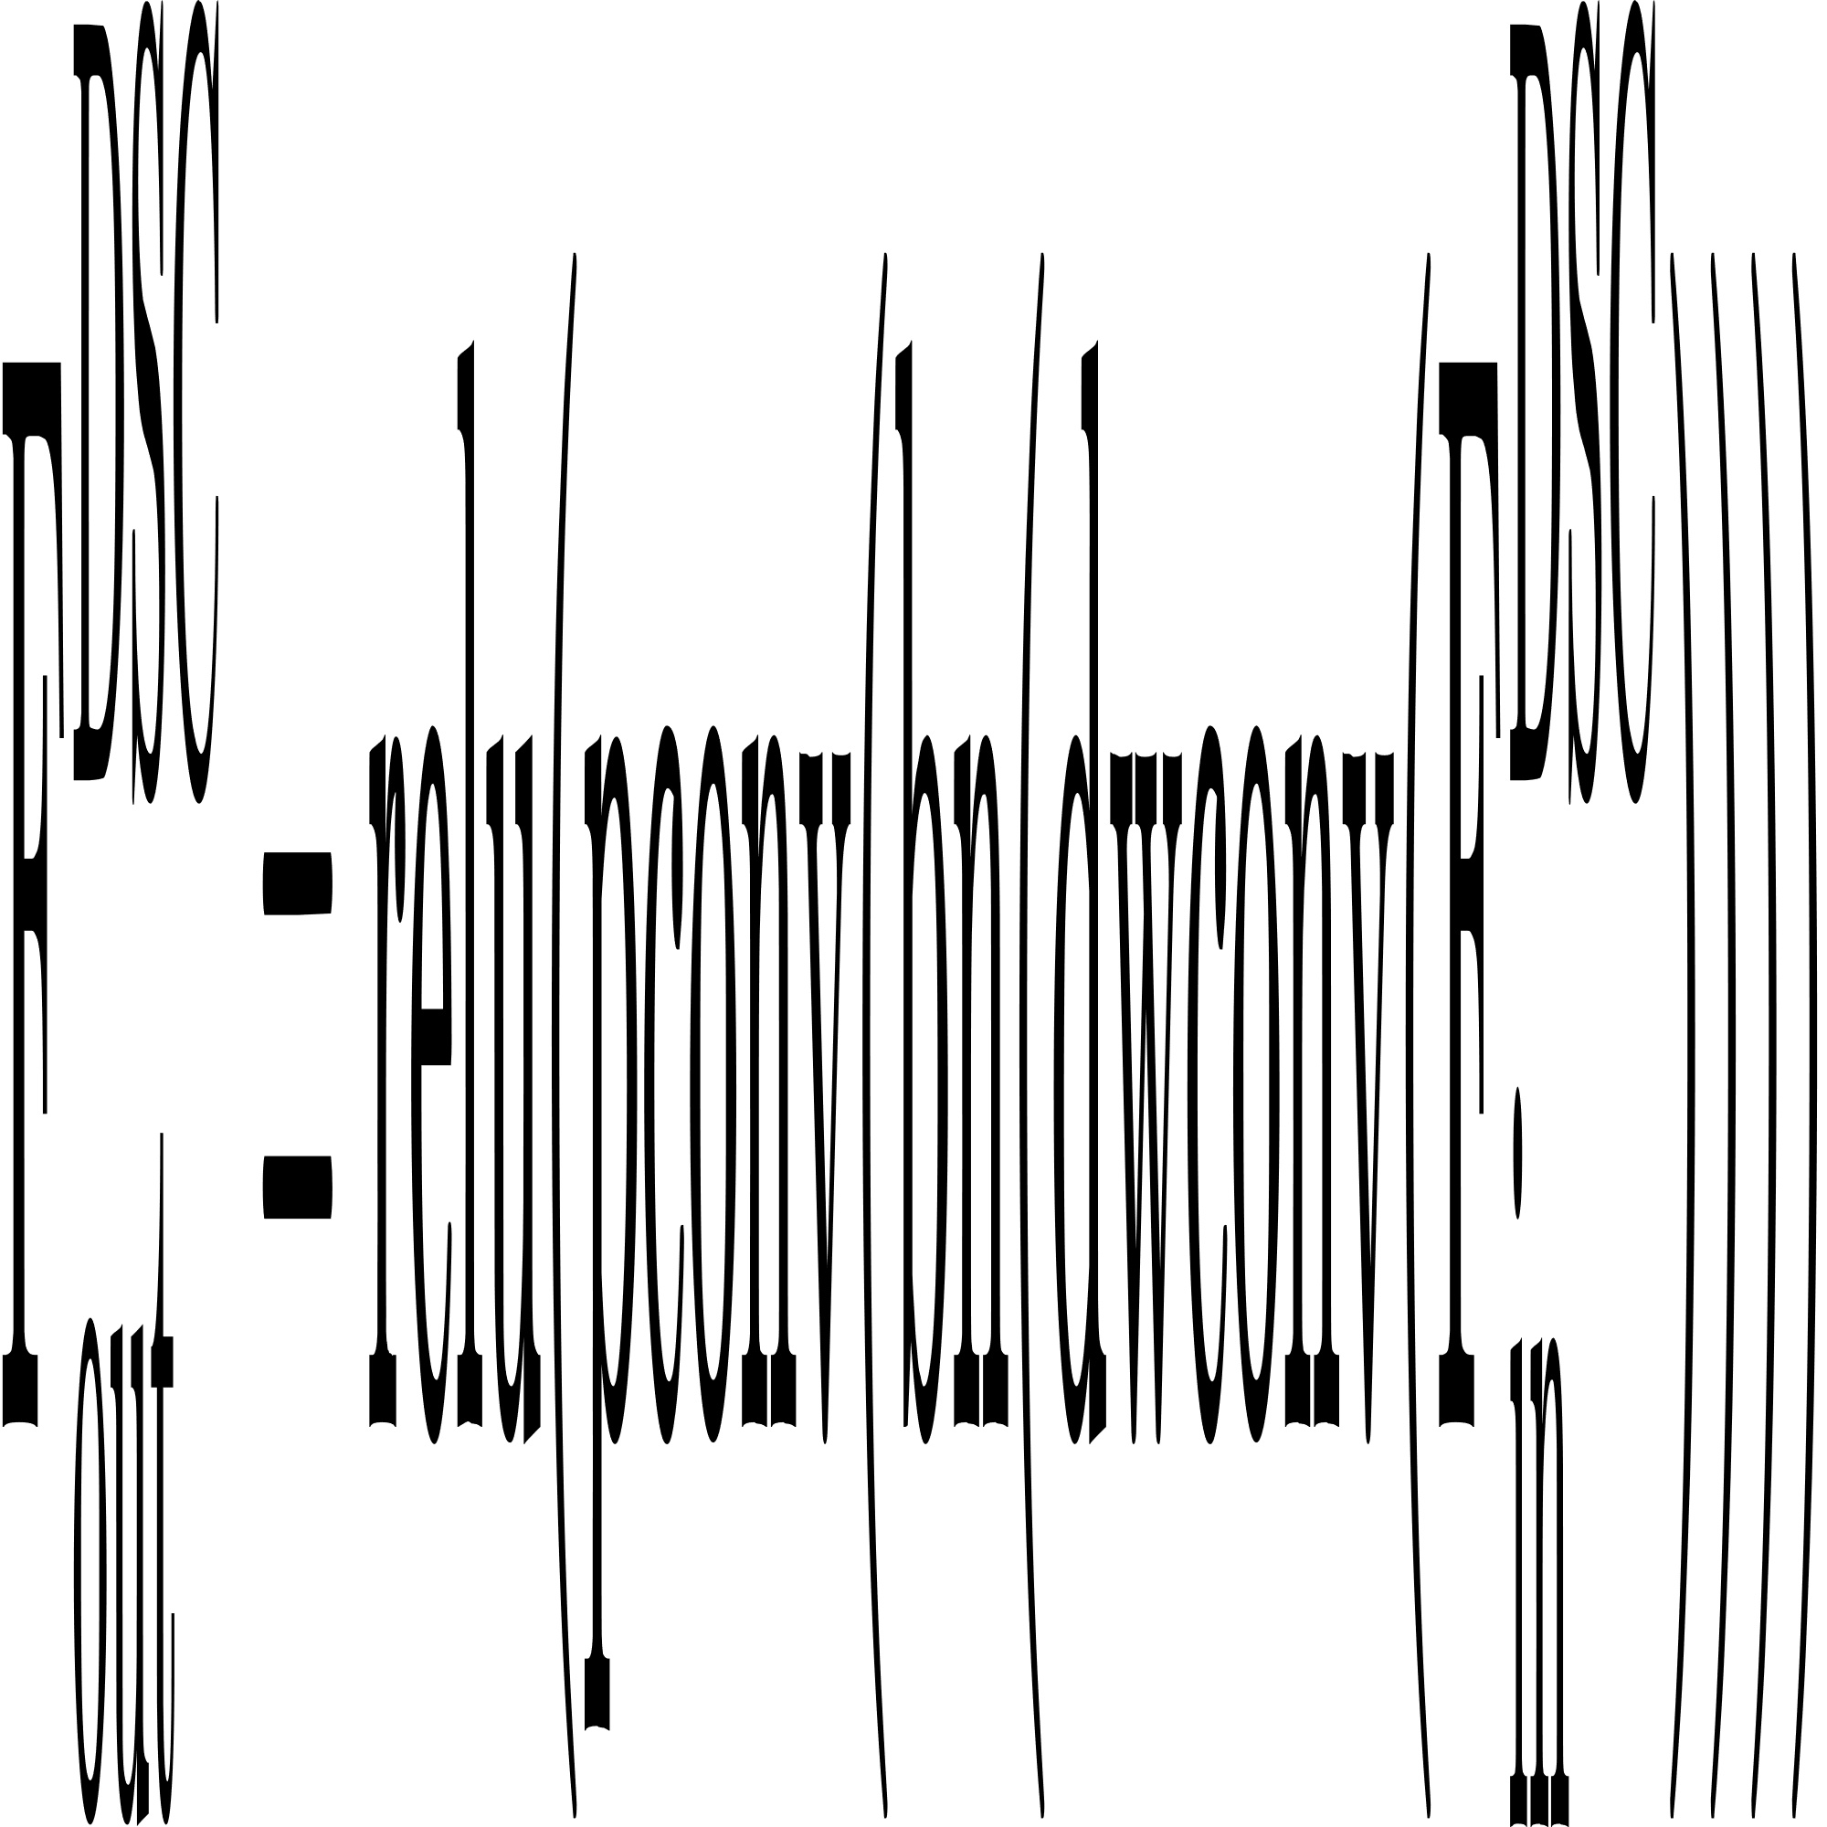
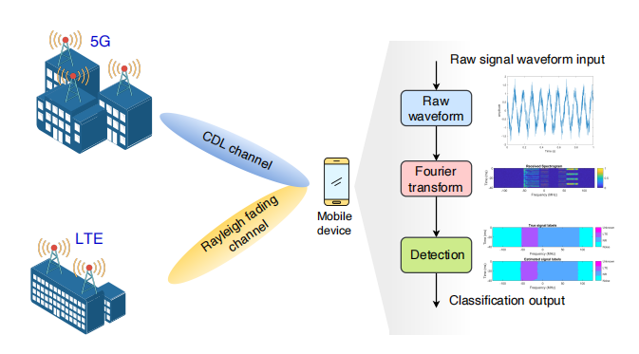
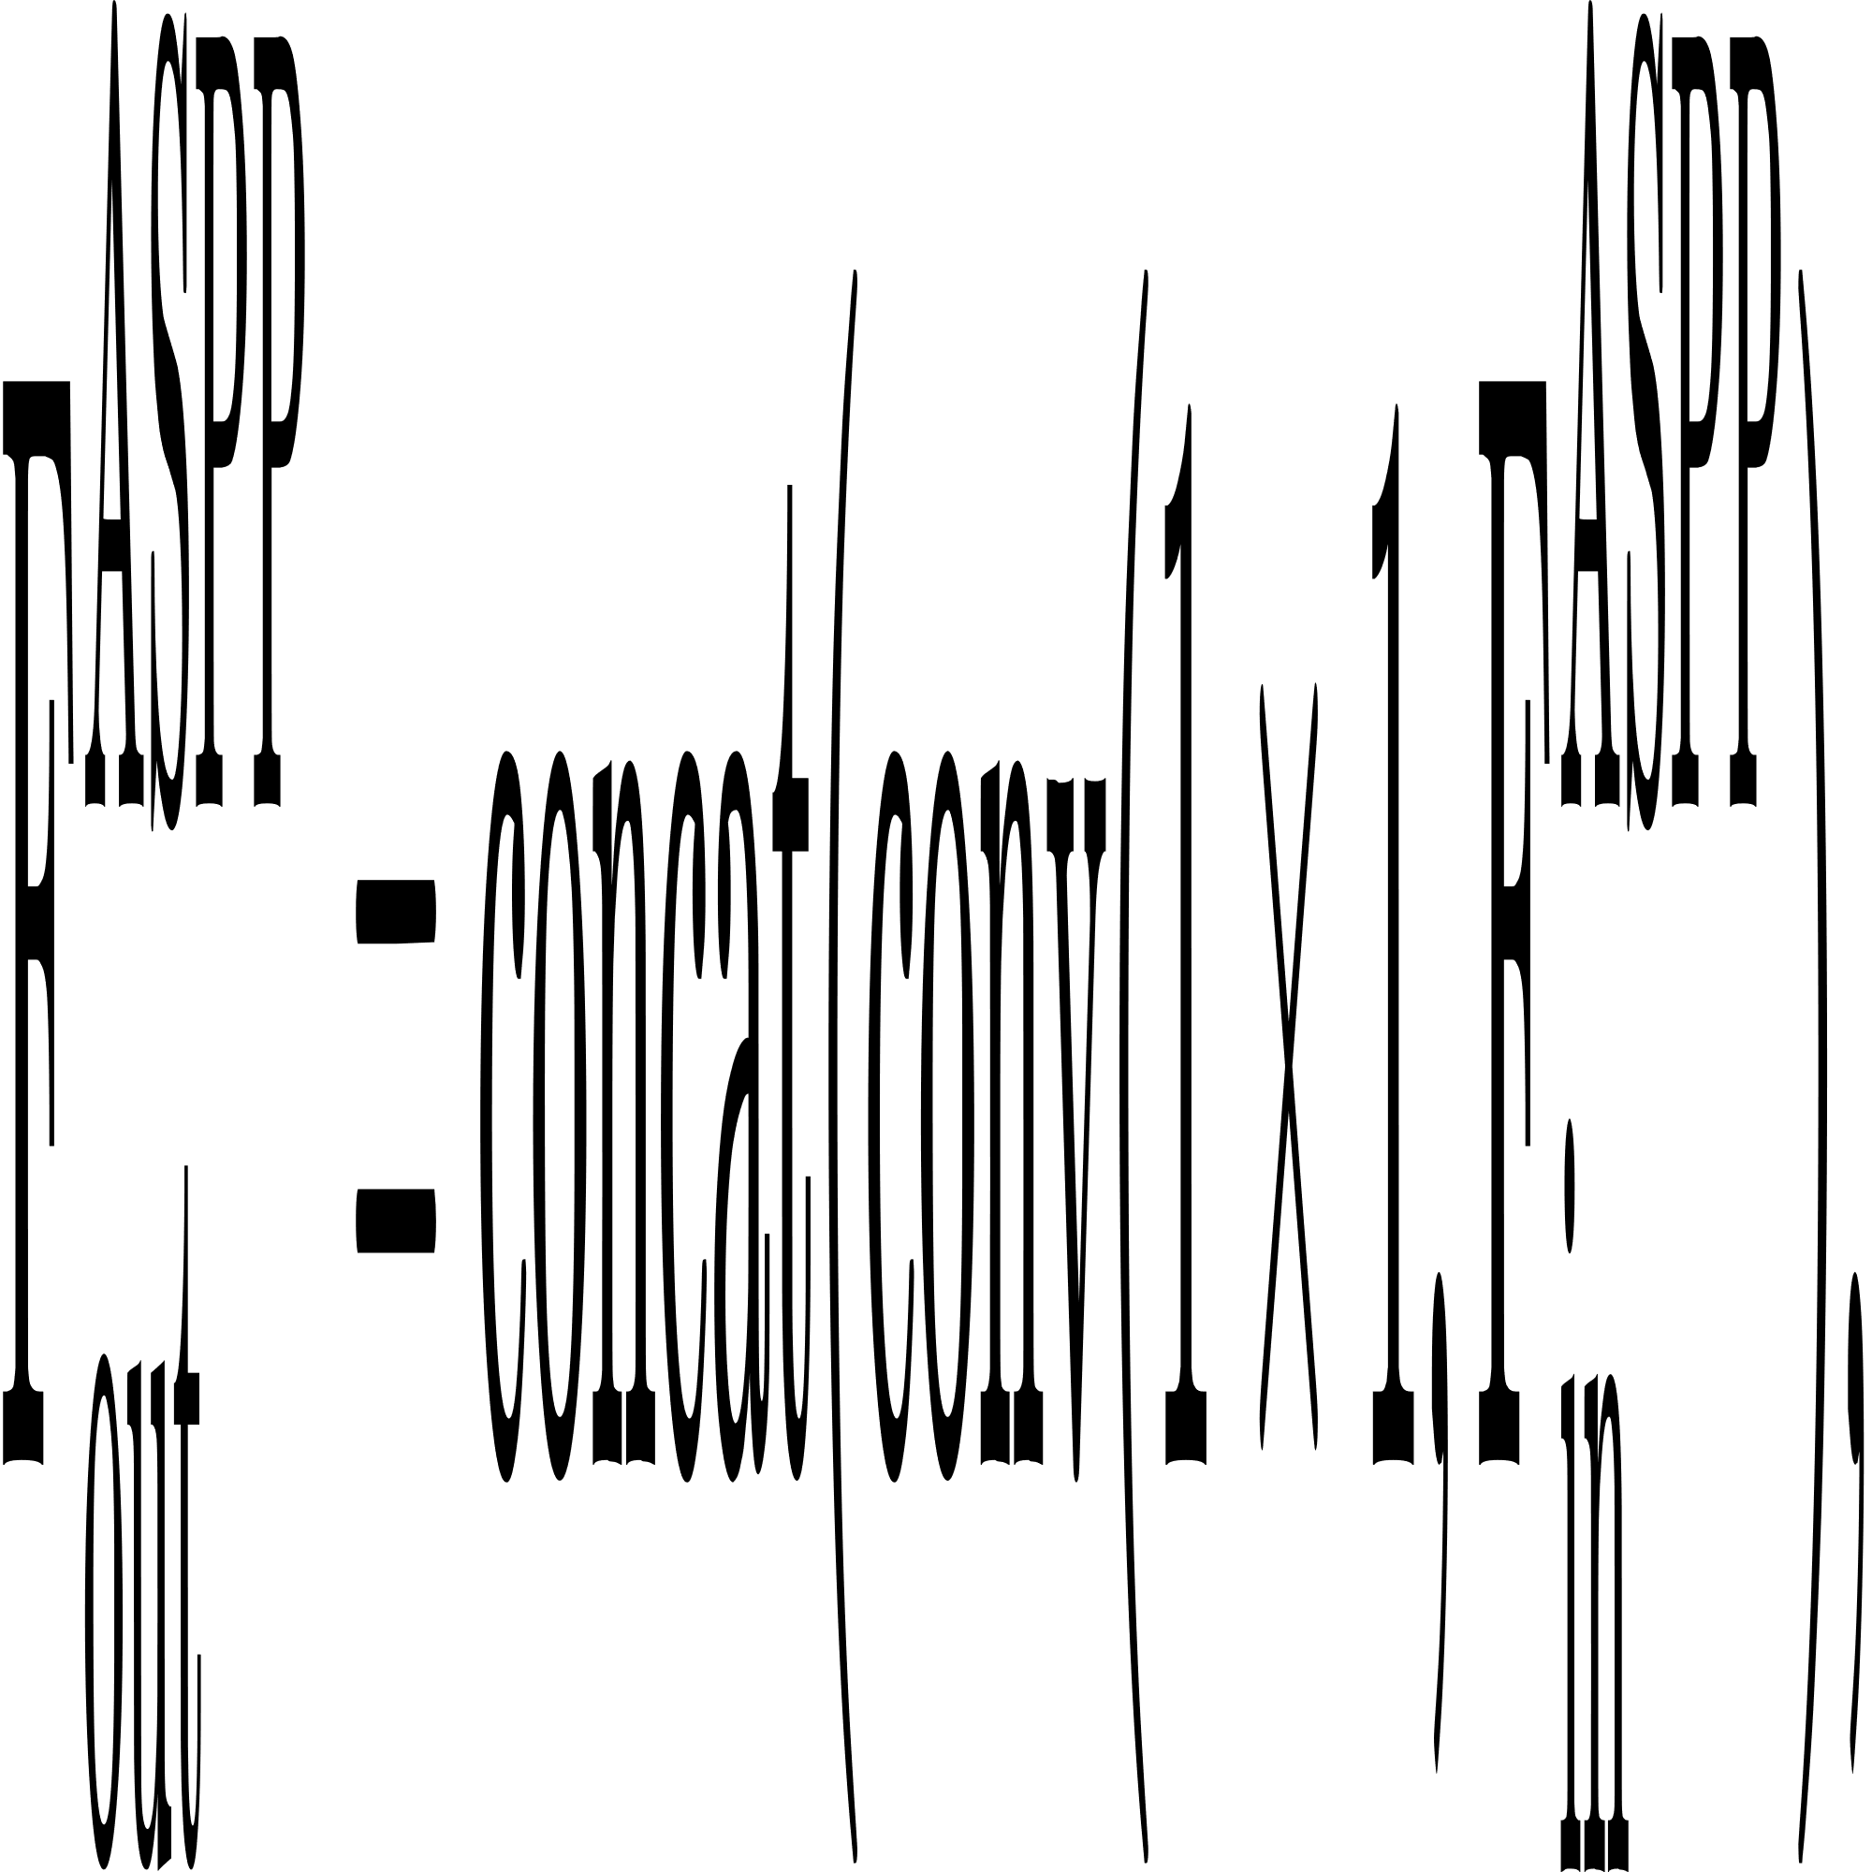
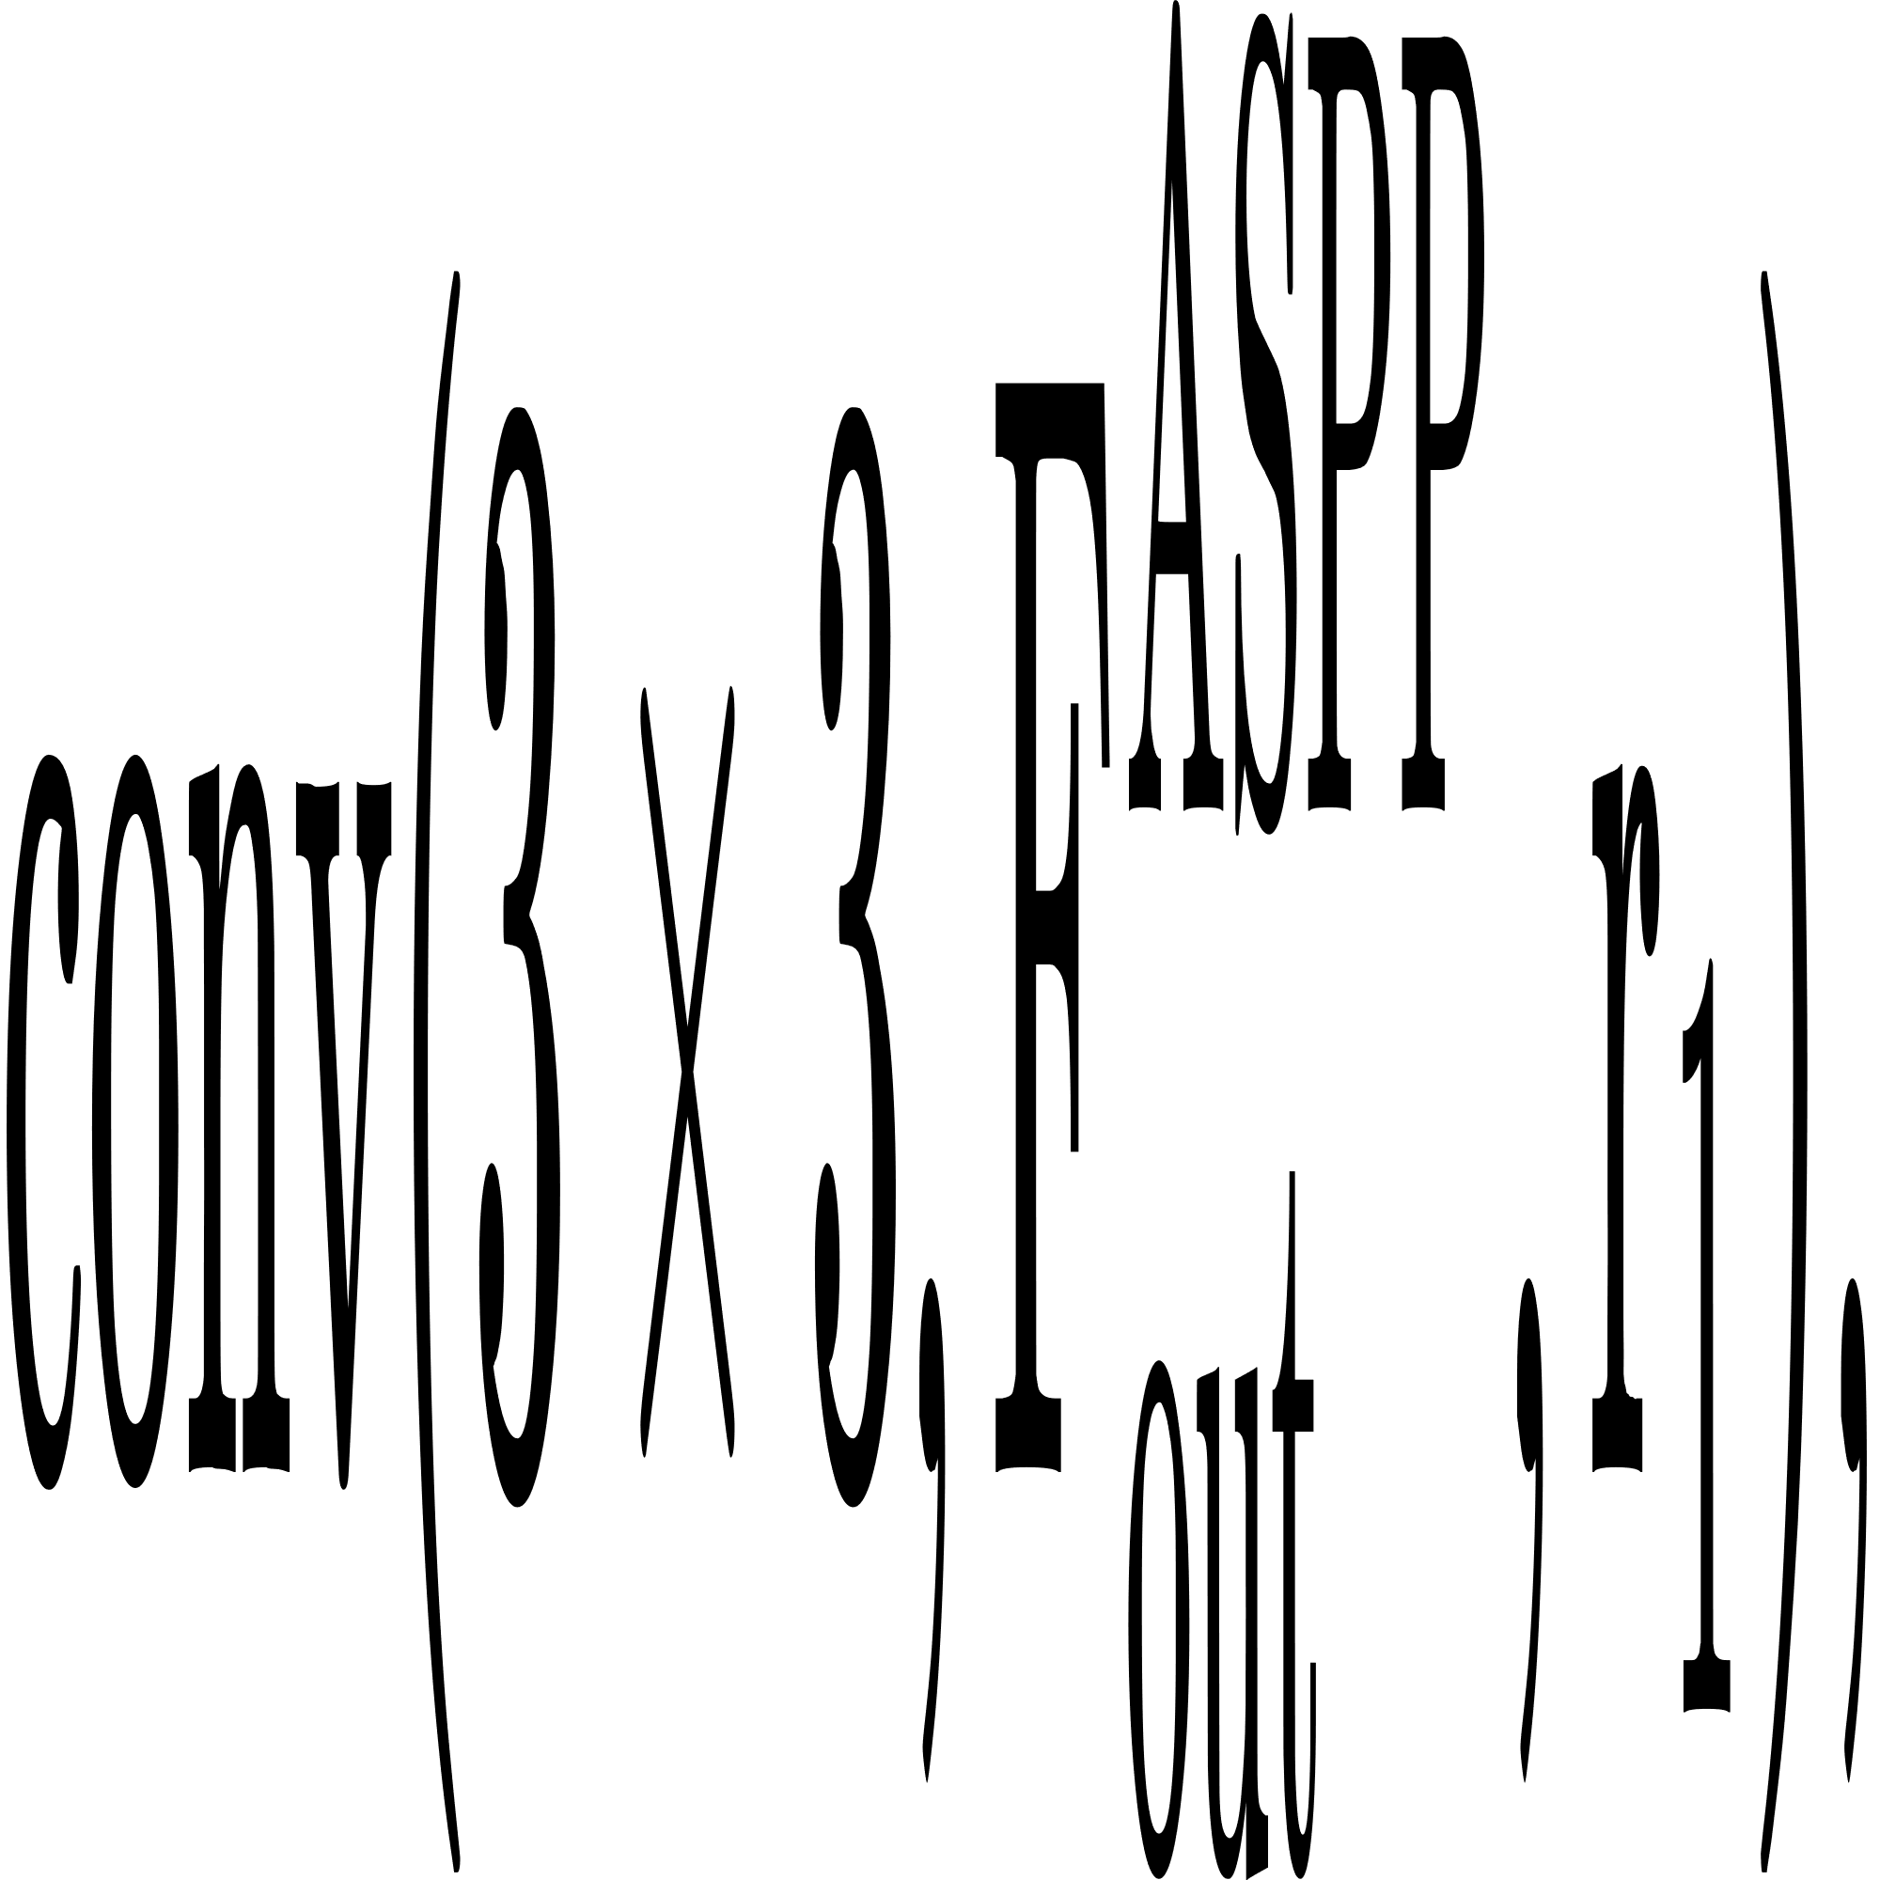
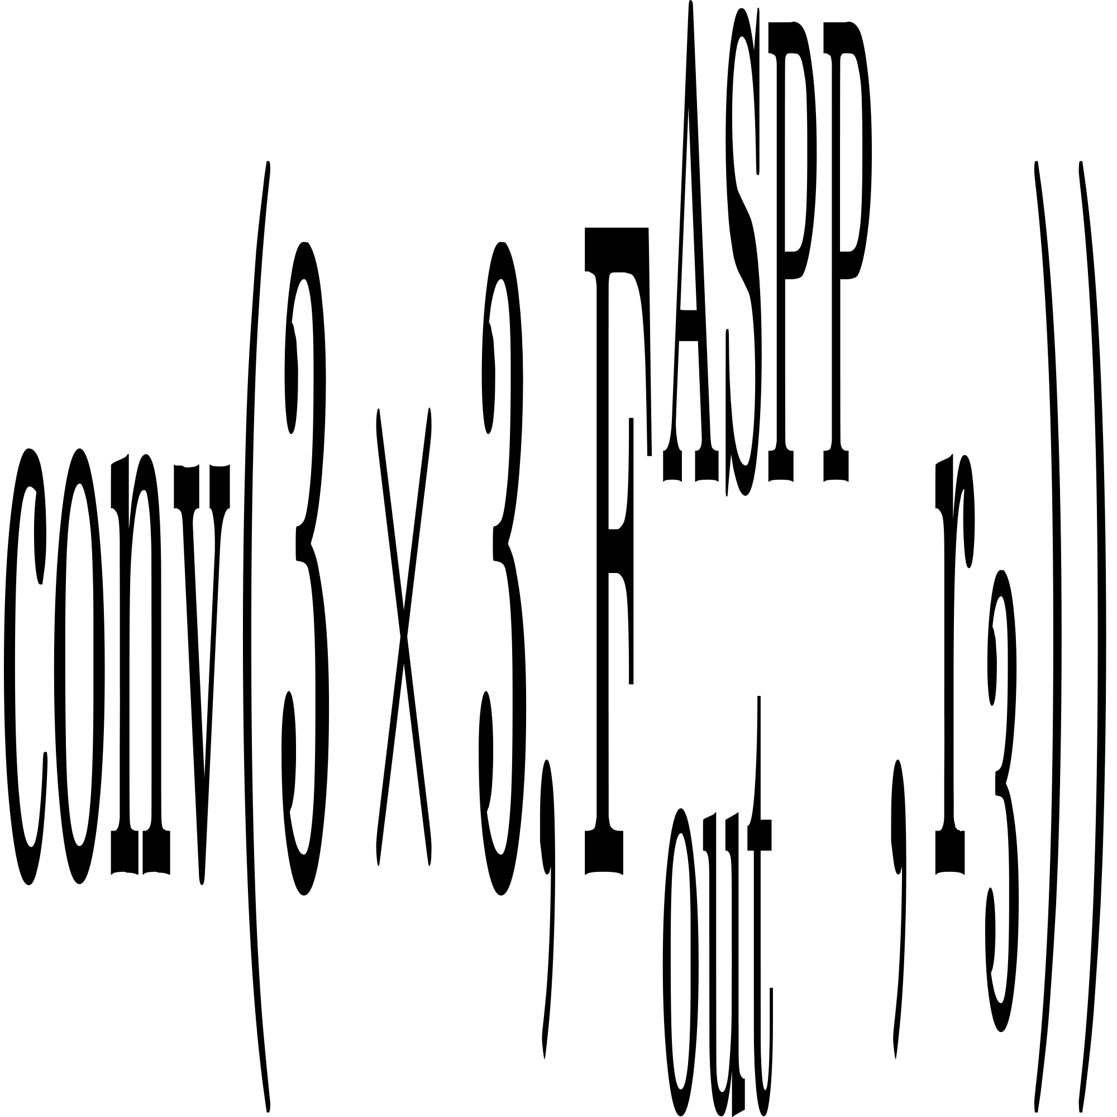
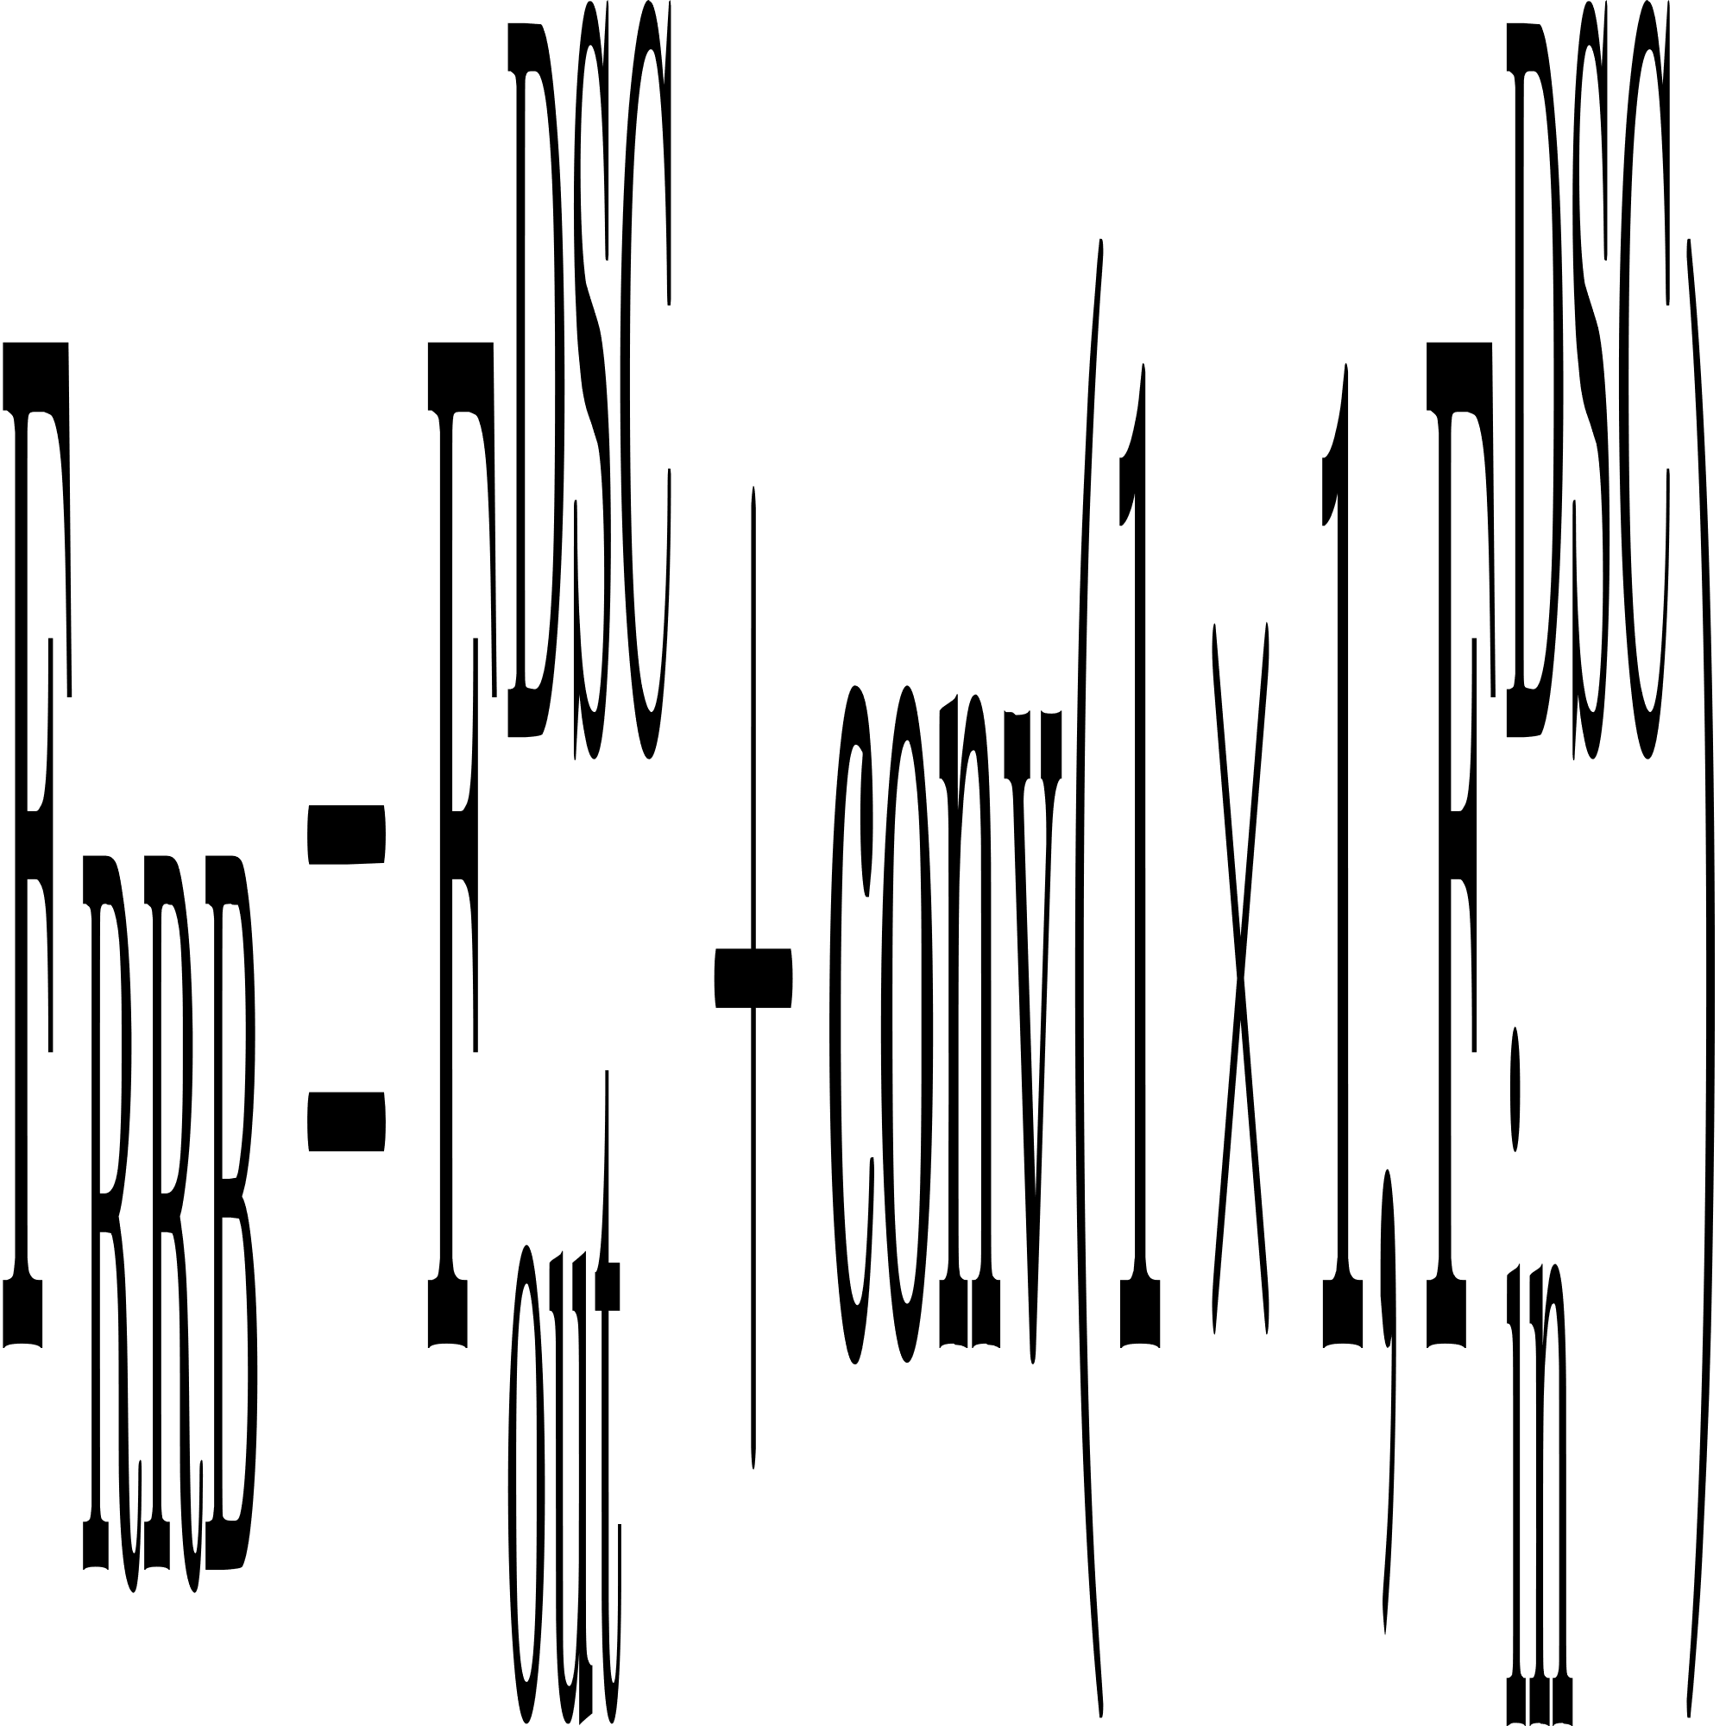
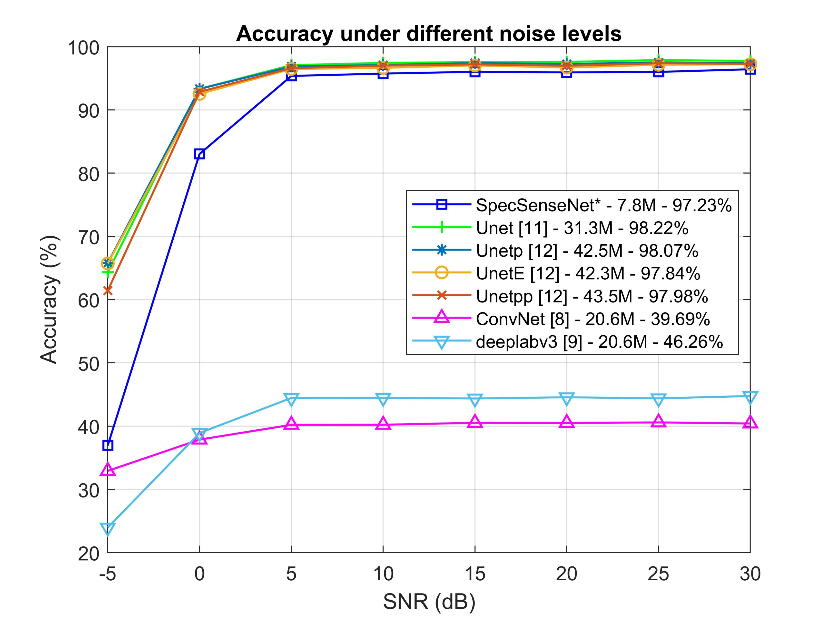
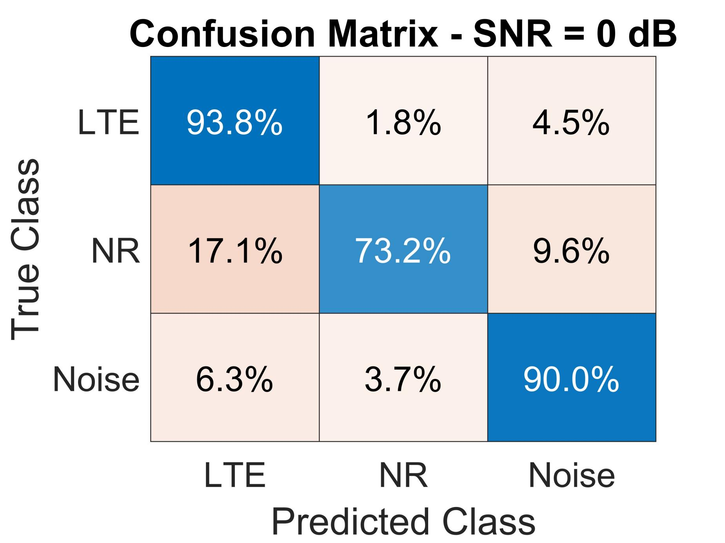
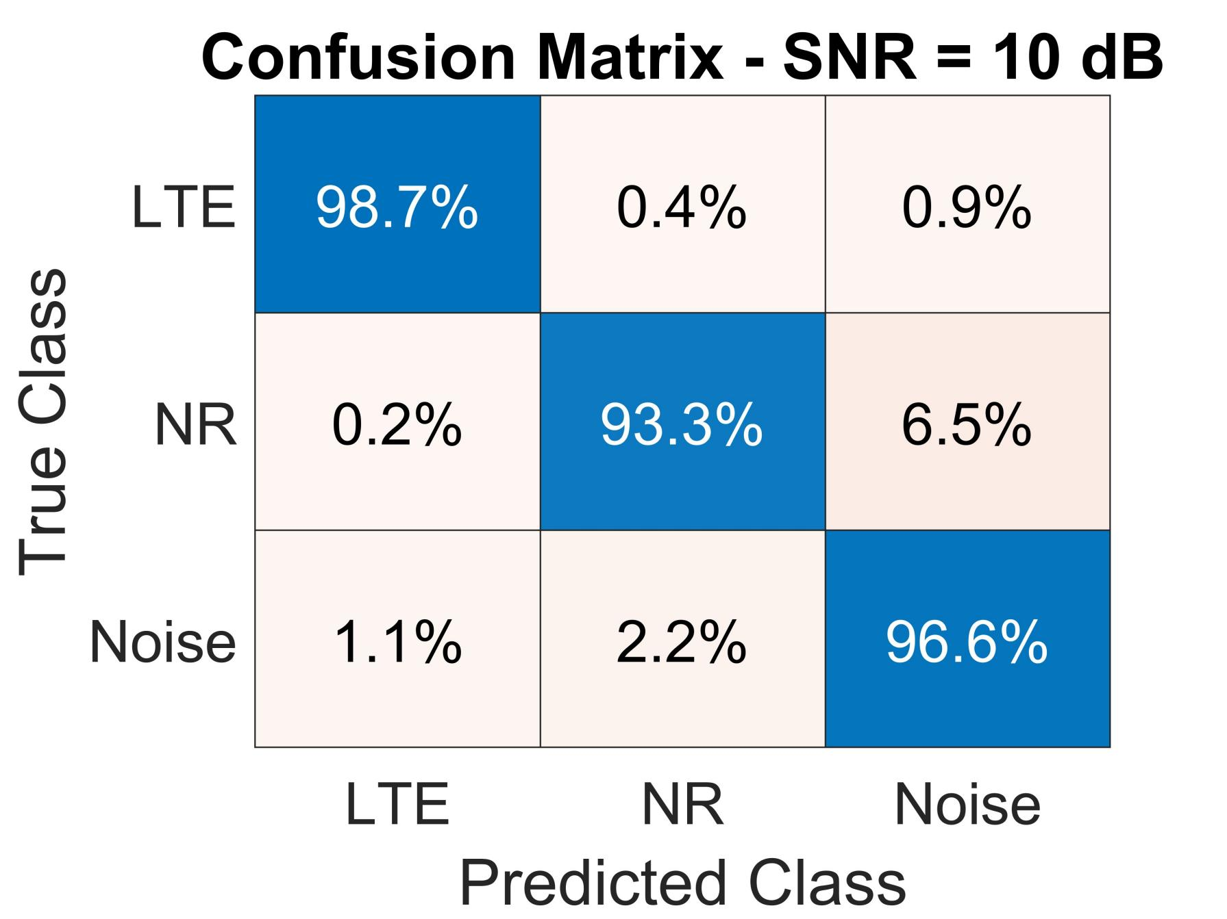
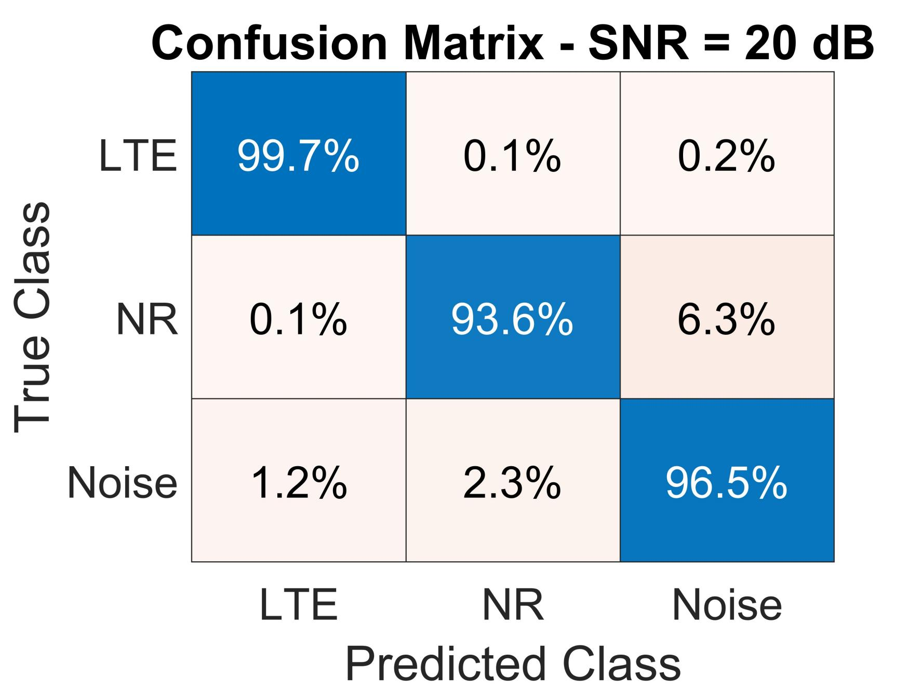

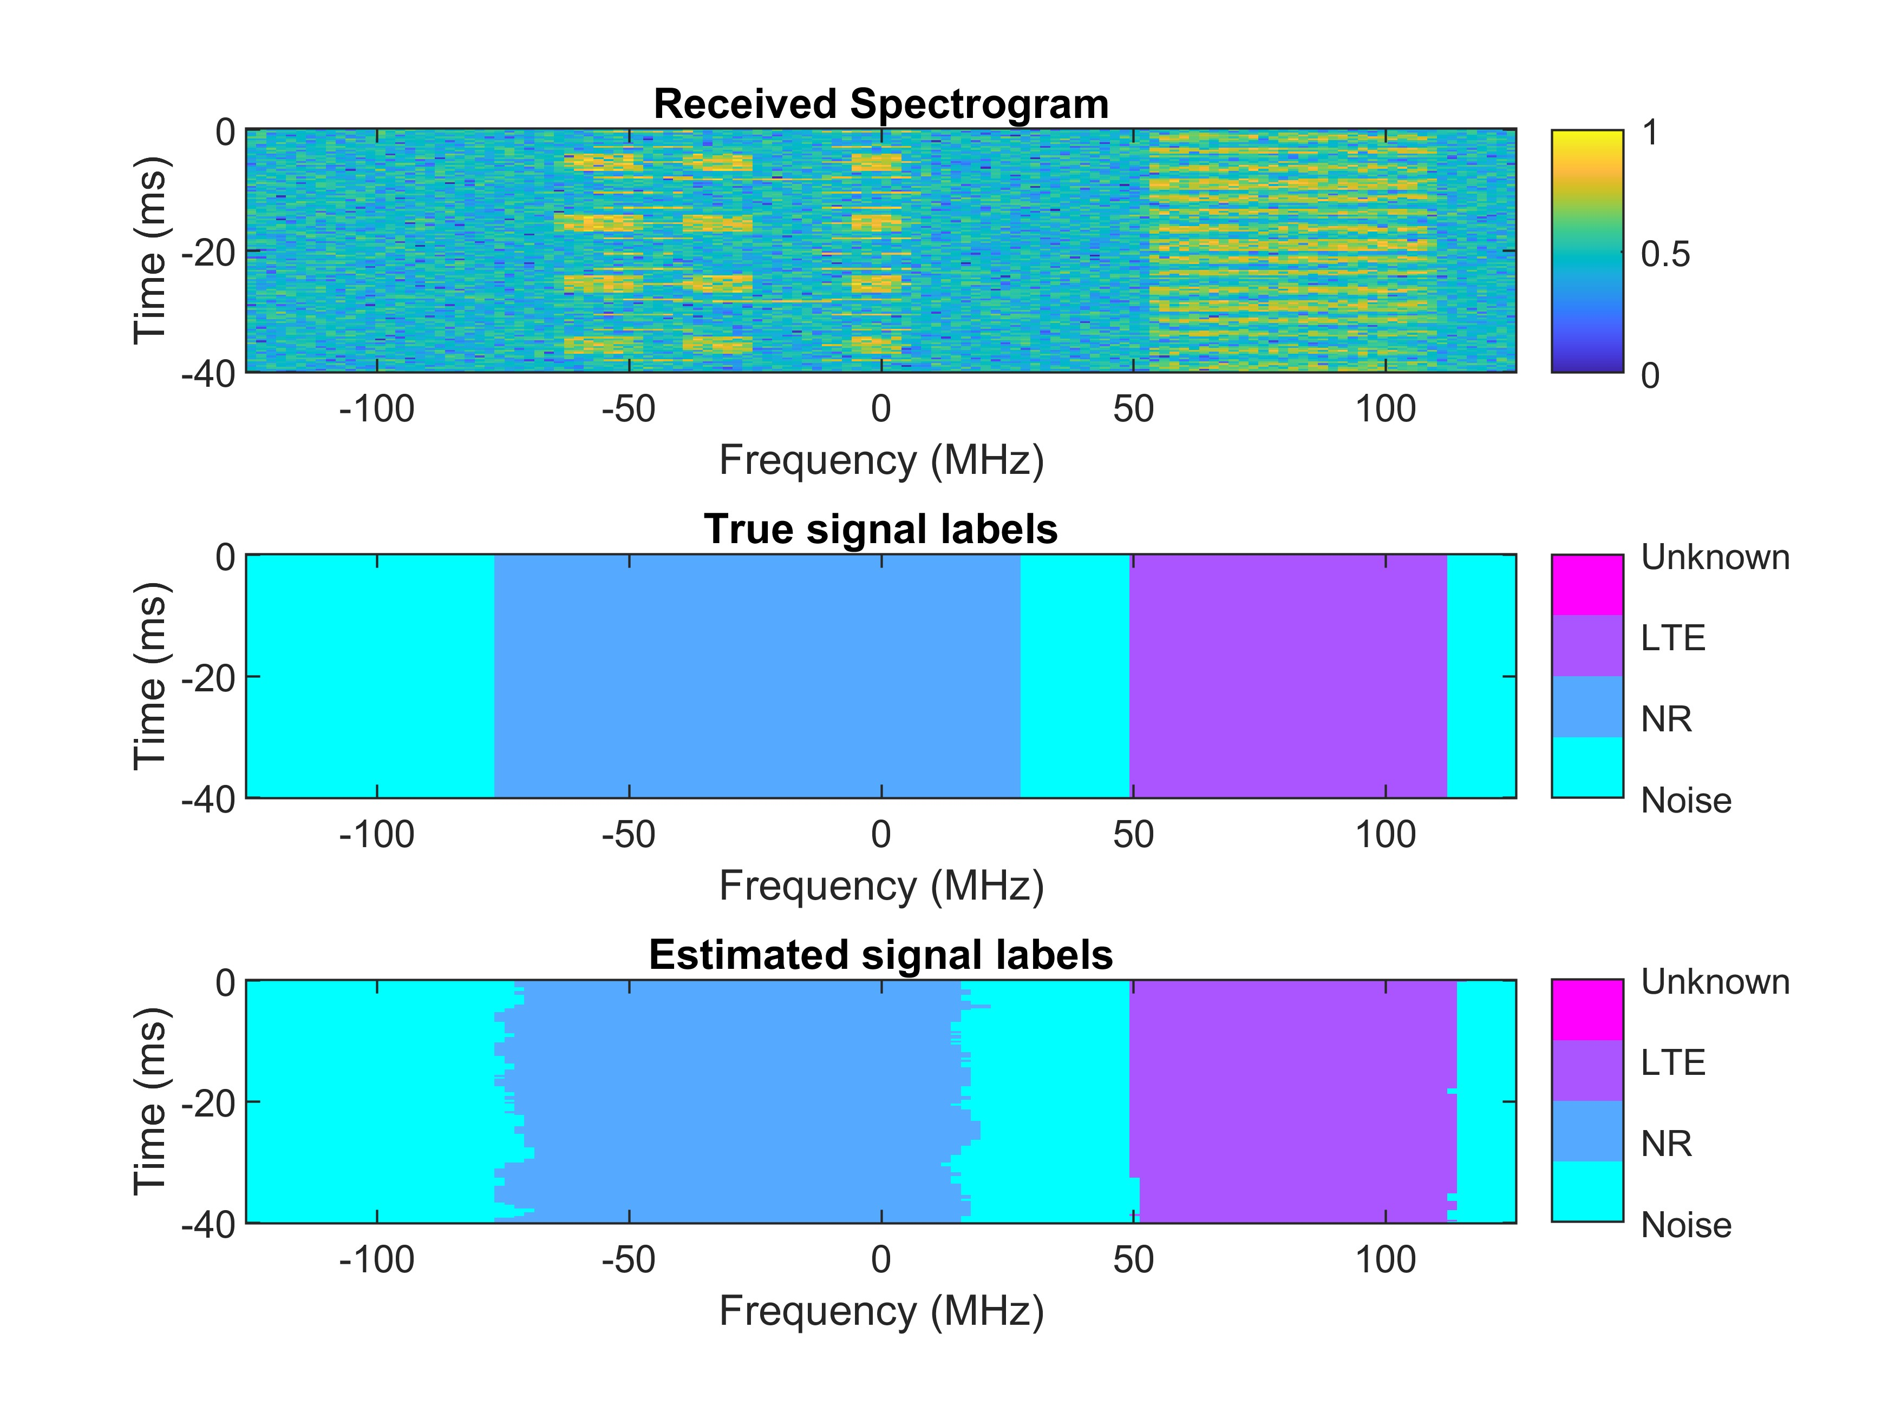
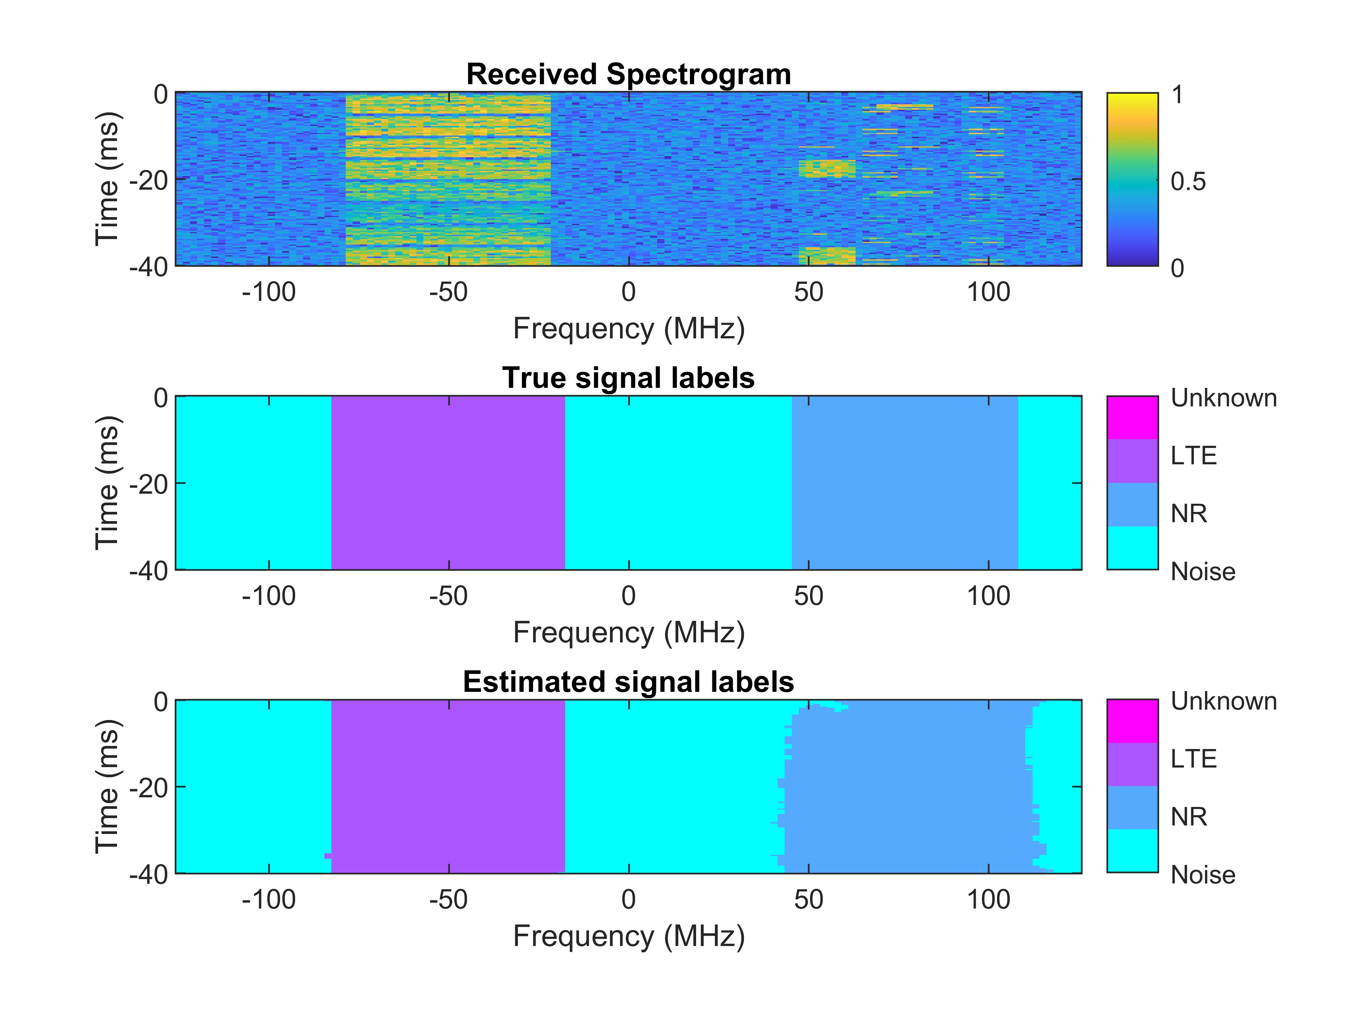


2024 International Conference On Advanced Technologies For Communications
Enhancing Spectrum Sensing For 5G and LTE
With Improved U-Net Architecture
Duy-Huan Nguyen, Toan-Van Nguyen, Thien Huynh-The
Abstrace
SpecSenSenseNet architecture
Spectrum sensing for wireless communication has a crucial role in next-generation networks, enabling devices to identify and adapt to the growing demand for wireless connectivity. In this paper, we address challenges in spectrum sensing and propose an innovative deep network, namely Spectrum Sensing Network (SpecSenseNet) for over-the-air communication sensing. SpecSenseNet is an architecture based on U-Net, incorporating advanced state-of-the-art deep learning techniques to optimize sensing performance. These approaches, including depth-wise separable convolution, recurrent residual blocks, and Atrous Spatial Pyramid Pooling, significantly reduce the trainable parameters of the network. Indeed, the network’s size is optimized while maintaining its prediction performance. As a result, SpecSenseNet reduces effectively its trainable parameters to 7.8M and maintain the same global accuracy at 97.23% compared to U-Net. In terms of evaluation, we generate a synthetic signal dataset containing two signal types, which are fifth-generation new radio (5G NR) and long-term evolution (LTE) adapted to various levels of additive noise in the range of [0, 30] dB. Regarding simulation results, SpecSenseNet demonstrates impressive prediction performance, even in high noise density environments. Notably, reducing the number of trainable parameters enhances model’sefficiency, generalizability, and ease of deployment.
Fig 2. The architecture of atrous spatial pyramid pooling module.
In particular, DSC is utilized as a convolution operator to replace for a regular convolution in the U-net architecture design. The output of DSC can be expressed as follows:
Spectrum sensing based on deep learning infrastructure
On the other hand, ASPP modules are employed within skip connection wires between encoder and decoder paths, they concatenate feature maps generated from the encoder path and pass them to the decoder path, they not only contain output feature maps in multiple receptive field sizes but also encode multiple scale informations, eventually boosting the performance of the network, the output of ASPP can be obtained as follows:
Spectrum sensing refers as identifying availability and non-availability of wireless communication networks or radio networks in particular frequency bands. When a traditional frequency allocation scheme cannot provide high data rate demand constantly, it leads to waste spectrum resources.These resources can be allocated for others in need, such fifth generation new radio or long-term evolution simultaneously. Therefore, spectrum sensing for 5G NR and LTE has become a main topic currently presenting many challenges, focusing on performance enhancement of monitoring and managing limited spectrum resources effectively
Furthermore, inspiration from the architectural innovation of RRB as introduced in and, we have revolutionized our network using RBB. Specifically, we have overhauled both encoder and decoder paths of our network by substituting the conventional U-Net convolution with RRB.
Fig 3. The architecture of SpecSenseNet.
Result
Fig 1. An overview of spectrum sensing for 5G and LTE.
Contribution
In this work, we leverage deep learning approaches to tackle sensing tasks and propose an innovative U-Net-based deep network architecture, called Spectrum Sensing Network (SpecSenseNet),which significantly reduces the network’s size while enhancing sensing performance for 5G and LTE signals. Notably U-Net is a well known convolutional neural network for its effectiveness in semantic image segmentation, it is designed with a parallel encoder and decoder paths and connected together by skip connection wires. Recently, U-Netpp and other variant models have shown notable improvements of segmentation accuracy; however, these models consume massive memory and computational resources. As a result,they are not suitable for resource-limited devices. To address this limitation, we present SpecSenseNet. The architecture incorporates depth-wise separable convolutions and recurrent residual convolutions within the encoder and decoder paths, replacing standard U-Net blocks. These modifications effectively reduce the network’s size without sacrificing segmentation accuracy. Additionally, Atrous Pyramid Spatial Pooling modules are inserted between the encoder and decoder paths to enhance the learning of relevant features at multiple scales. In summary, we make the following three main contributions:
Addressing spectrum sensing for 5G and LTE problems and utilizing DL approaches to tackle spectrum sensing.
Introducing an innovative SpecSenseNet architecture based on U-Net that optimizes the network’s size and maintains sensing performance for 5G and LTE signals.
By reducing SpecSenseNet’s trainable parameters, the model’s efficiency, generalizability, and ease of deployment are enhanced, leveraging state-of-the-art approaches.
Fig 4. Method comparison under different SNR regimes.
Fig 5. Confusion matrix in different SNR levels
Fig 6. Visualization of received spectrograms in SNR levels: 5 (dB) and 15 (dB).
Conclusion
In this paper, we introduced SpecSenseNet, a novel deep learning architecture based on U-Net. SpecSenseNet achieves impressive performance in spectrum sensing for 5G and LTE under various SNR levels. Our work addresses the challenge of applying deep learning to spectrum sensing tasks. The proposed network leverages cutting-edge deep learning techniques to significantly reduce the number of trainable parameters compared to U-Net and other variants. This reduction in complexity enhances the efficiency of both training and prediction phases. In summary, simulations demonstrate that SpecSenseNet achieves robust classification for 5G and LTE spectrum sensing, even in the presence of high additive noise. This performance makes SpecSenseNet well-suited for real world deployments.
huan2931@gmail.com, vannguyentoan@gmail.com, thienht@hcmute.edu.vn

